Slide 1
https://youtu.be/dnkcmDETeGg

Slide 2
GNUstep Conceptual Architecture
Rodrigo Del Aguila | Lucas Ferber | Robert He | Vlad Kukov | Enqi Liang | Luc Robitaille (group leader)

Slide 3
TABLE OF CONTENTS
01
02
03
Overview
Architecture
Components
04
05
06
Operation
Use Cases
Conclusion
Abstract and general Introduction
System Architecture and Subsystems
External interfaces, system evolution,
Data and flow control, concurrency, responsibilities
Use cases, data dictionary, naming convention
Lessons learned, Conclusion and references

Slide 4

What is GNUstep?
GNUstep is an open source object-oriented development environment originally derived from the OPENstep API and utilizing the NEXTstep framework that provides the user with a large range of utilities and libraries for building large, cross-platform, applications and tools.

Slide 5
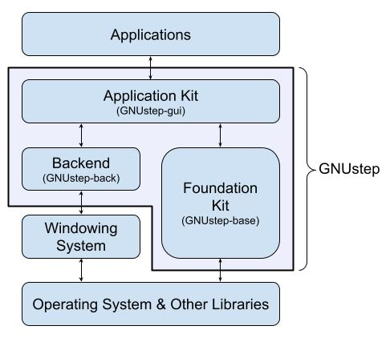
ARCHITECTURE
ARCHITECTURE DIAGRAM HERE

Slide 6


ARCHITECTURE
Application Kit
Foundation Kit
The Application Kit defines Graphical Objective C classes.
The Foundation Kit defines non-graphical Objective-C classes

Slide 7
ARCHITECTURE (contd.)
Backend
The Backend Subsystem is actually a series of libraries each designed for a specific windowing system.

Slide 8
EXTERNAL INTERFACES
Gorm
Objective-C Runtime & Compiler
Gorm is an interface modeler that builds and implements items from the GNUstep GUI Library for creating graphical applications.
GNUstep, developed in Objective-C, compiles its code into machine code for execution. GNUstep-base handles communication with the Objective-C library.
Windowing System
The Windowing System renders graphical applications on a computer screen.

Slide 9
COMPONENTS
Libs-Base
Libs-Back
Libs-gui
This library is responsible for some of the fundamental actions for an application
This library is responsible in handling rendering and events for the gui library
This library is responsible for frontend processes related to gui.

Slide 10
SYSTEM EVOLUTION
Libs-Base
Libs-Gui
Gorm
Version History
Version History
Version History
Ver. 0.1.19(Expanded classes and reorganized structure)
Ver. 0.5.5(Rewritten NeXTstep classes for enhanced performance and usability)
Ver. 1.15.4(Improved MacOS compatibility)
Ver. 1.23.0(Added Objective-C 2.0 support with ARC)
Ver. 1.31.0(Ongoing runtime improvements)
Ver. 0.1(Enhanced GUI elements, system color configuration, and improved compatibility)
Ver. 0.2(Optimized printing, auto-saving in documents, and better MacOS compatibility)
Ver. 0.32(Introduced unique application icons, improved mouse tracking)
Ver. 0.1(Introduced core UI functions)
Ver. 0.5(Added sound and image support with enhanced multi-selection and performance.)
Ver. 1.0(Improved usability with menu restoration, alert panels, enhanced font widgets, cut/paste, and alignment tools)
Ver. 1.4(Simplified matrix creation)

Slide 11
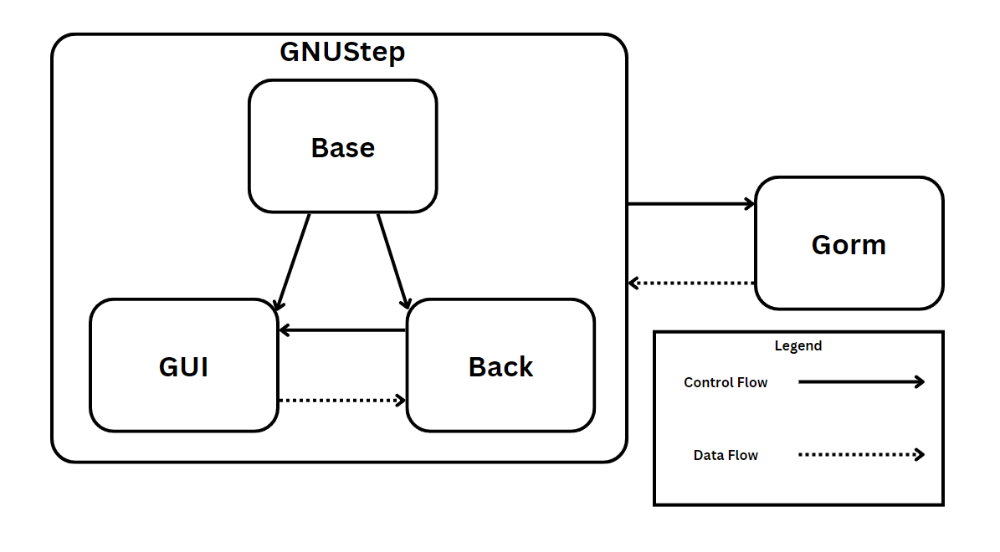
DATA & FLOW CONTROL
Base
Back
The Base library has control flow over the Back and GUI library
The Back library has control flow over the GUI library
GUI
Gorm
The GUI library sends data to the Back library
This application sends data into the GNUStep API, and is controlled by the GNUStep API

Slide 12
CONCURRENCY
Instances
Purpose
Gorm interacts with the GNUstep API, causing multiple libraries to execute concurrently.
GNUstep's design necessitates asynchronous library execution, introducing concurrency even in single-threaded processes.

Slide 13
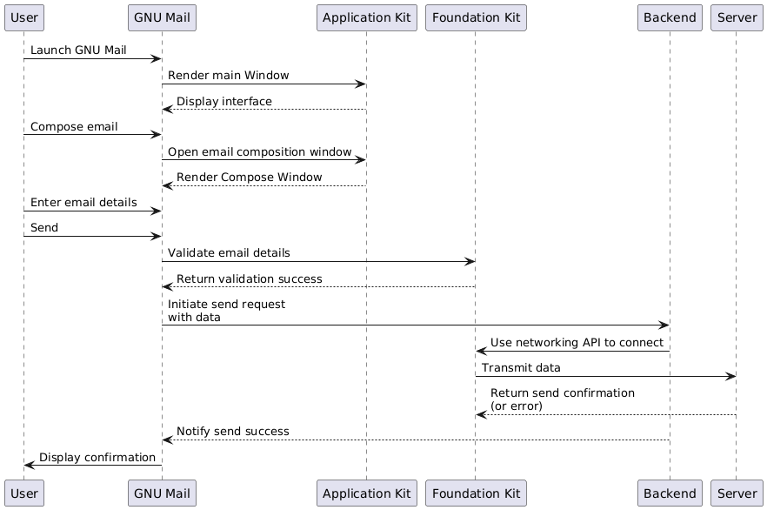
USE CASES: GNUMail

Slide 14
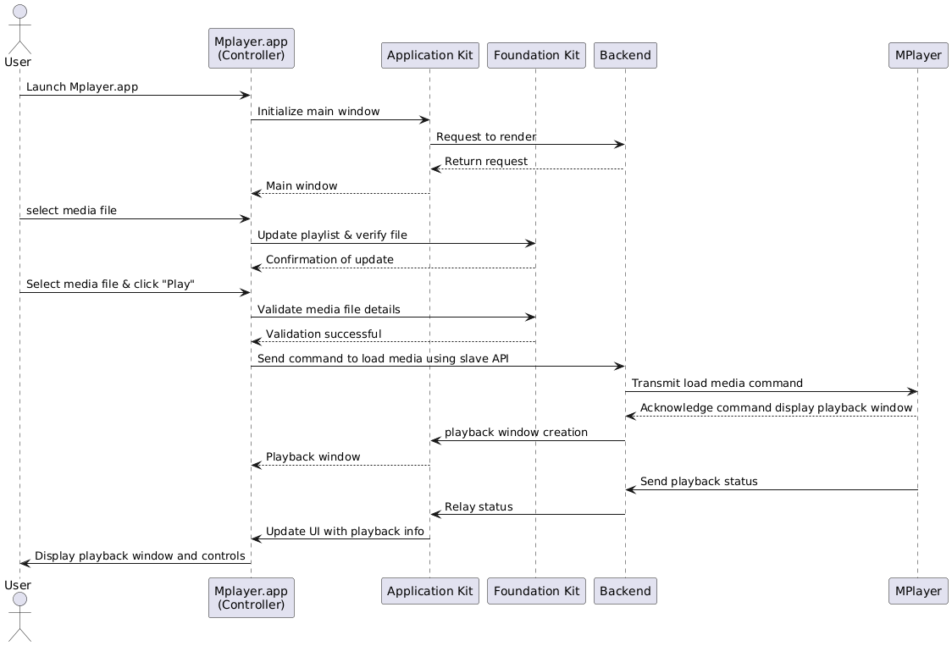
USE CASES: Mplayer

Slide 15
Data Dictionary
Framework
Bundle
Plug-in
Loadable bundle
Palette
Tool
Application

Slide 16
Naming Conventions
GSXML
GS/GC
GSHtml
GSLazy
GSMime
GORM

Slide 17

CONCLUSION
GNUstep's architecture is made up of 3 main subsystems:
Application Kit, Foundation Kit, and Backend library.
Based on the NeXTSTEP framework, GNUstep also interacts with external interfaces like the Gorm application for GUI creation.
Due to outdated documentation, we propose updating the resources to better explain the system architecture.

